Slide 1
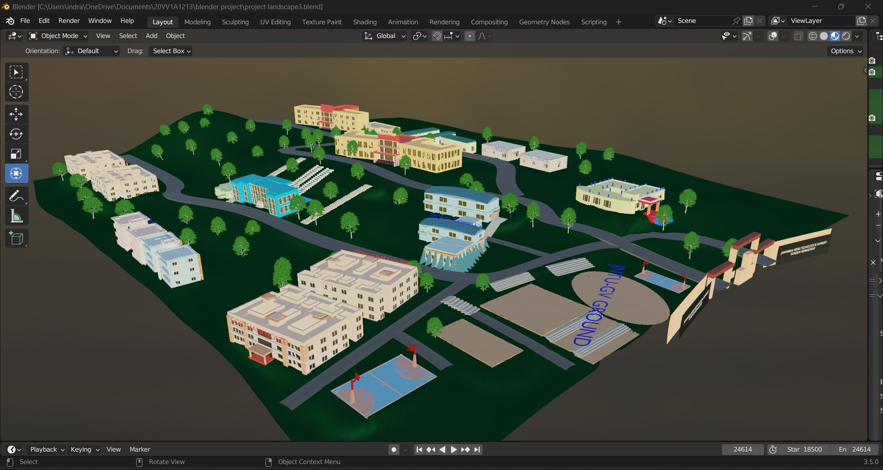
LIVELINESS of JNTU-GV
B. Kavya Sri (20VV1A1209),
B.Sai Kiran (20VV1A1211),
D.Mohanaa Vishnu Priya (20VV1A1213),
G.Siva rama Krishna (20VV1A1215)
,M.S.S.P Anuraag (20VV1A1238),
P. Dileep Kumar (20VV1A1251),
R.Sangeetha (20VV1A1255)

Slide 2
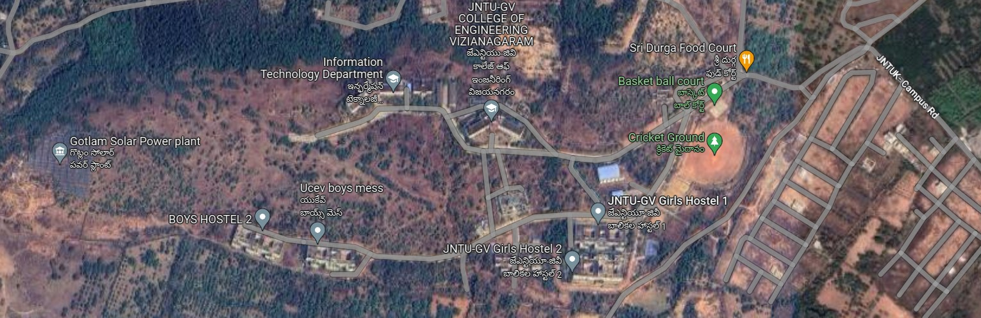

AGENDA
To pinpoint the properties of
the college using layout
Tool
Designing the properties
Arrangement of properties
Rendering process of the animation

Slide 3
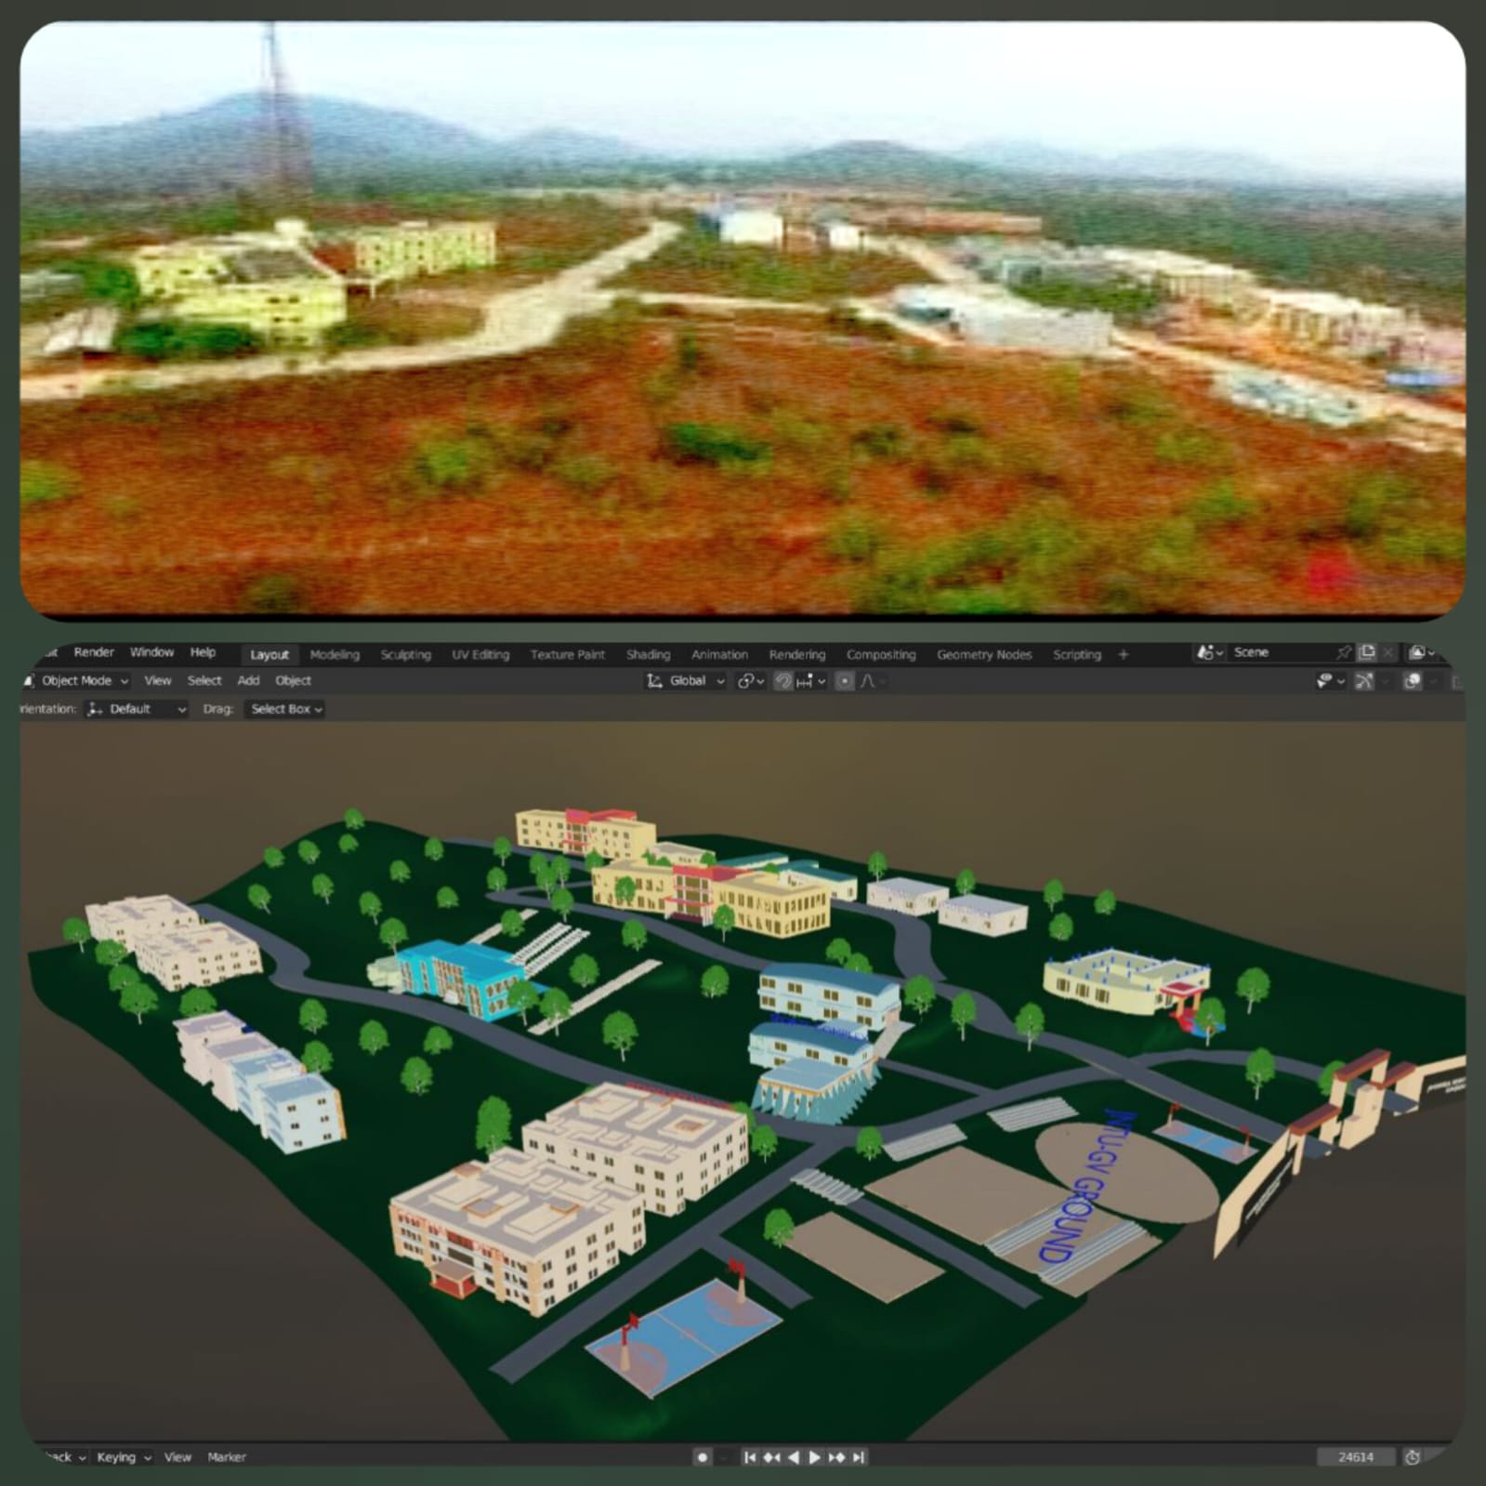
ABOUT OUR PROJECT
This project is animating the JNTU-GV University of engineering ,Vizianagaram .The JNTUK University College of Engineering Vizianagaram has been established during September 2007.It is beautifully constructed on a top of a small hill. Infrastructure is well developed ,it also has a very good view of the whole town. The JNTU-GV College was chosen to animate to show it’s beauty of Infrastructure.To portrait the same beauty into anime we used Blender..The Liveliness of JNTU-GV college is the main aim to project through this animation using Blender Software.

Slide 4
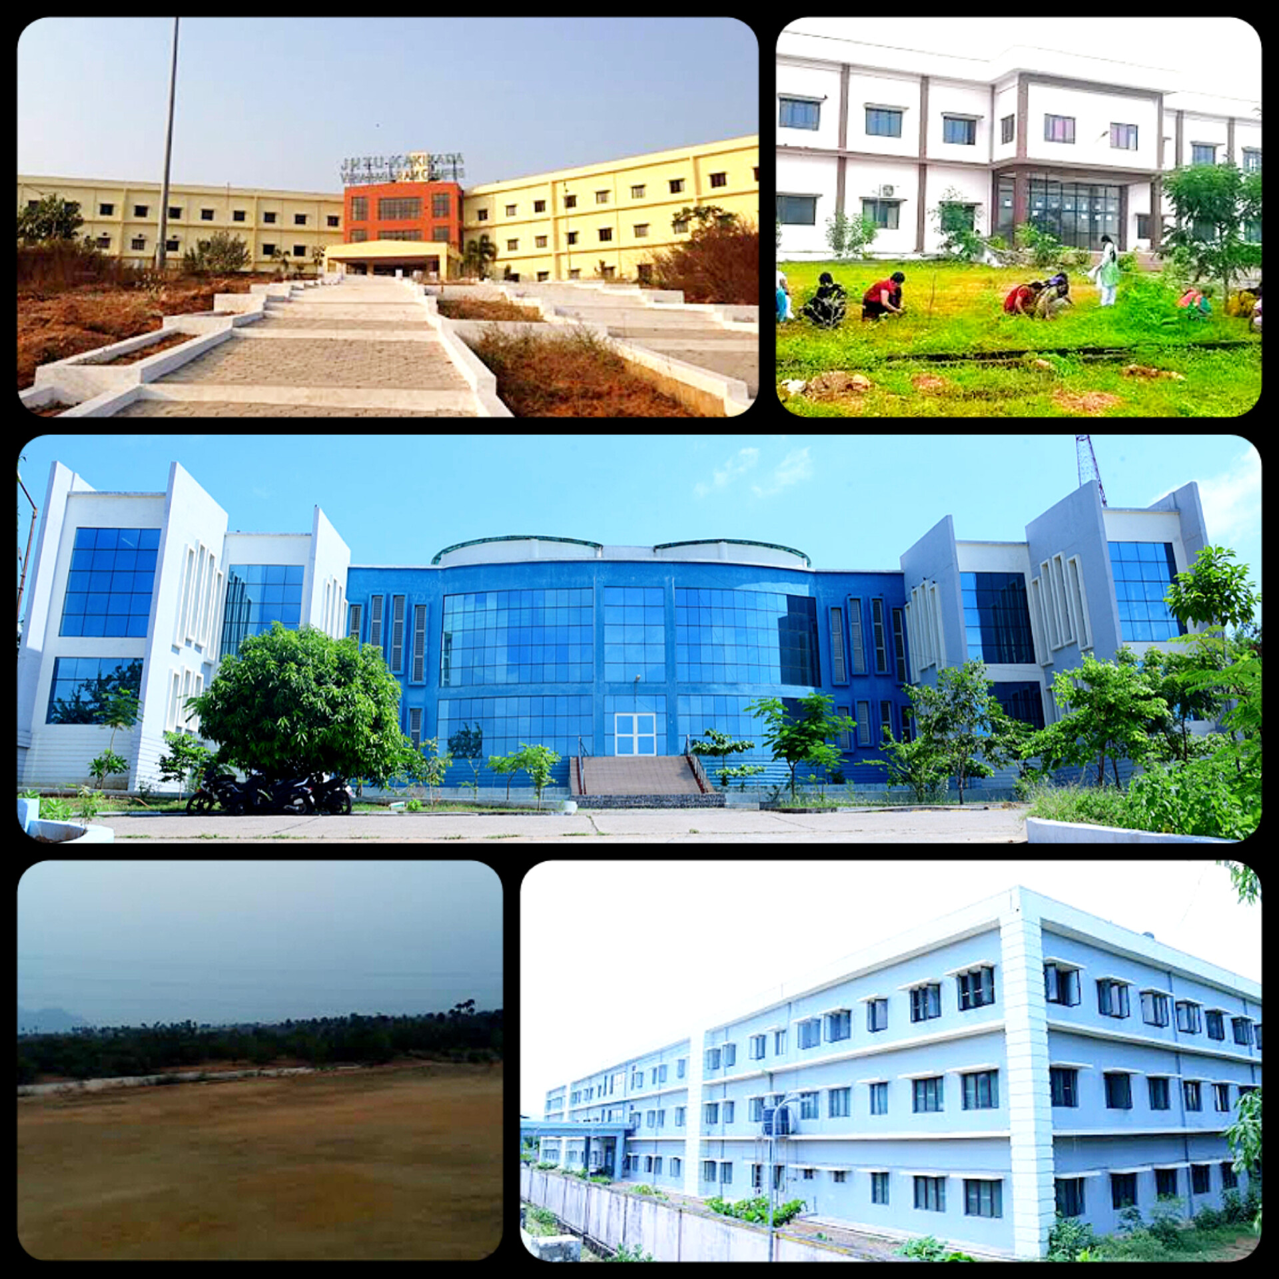
To pinpoint the properties of the college using layout

Slide 5

BLENDER
Blender is the free and open source 3D creation suite. It supports the entirety of the 3D pipeline modeling, rigging, animation, simulation, rendering, compositing and motion tracking, even video editing and game creation. Advanced users employ Blender’s API for Python scripting to customize the application and write specialized tools; often these are included in Blender’s future releases. Blender is well suited to individuals and small studios who benefit from its unified pipeline and responsive development process.

Slide 6
DESIGNING THE PROPERTIES
Using Blender we started constructing the properties
Firstly ,started studying the layout of the college.
Later constructed the landscape similar to realworld.
Started working by making a list of infrastructure present in the college
Began building up every single exterior framework that is situated
Grooming them on to the landscape
Adding further details
Trees
Roads
Stairs
Entrance
Finally took a shot showing the arrangement usinf the process of rendering
Showing every single detail present in the constructed anime of college landscape

Slide 7
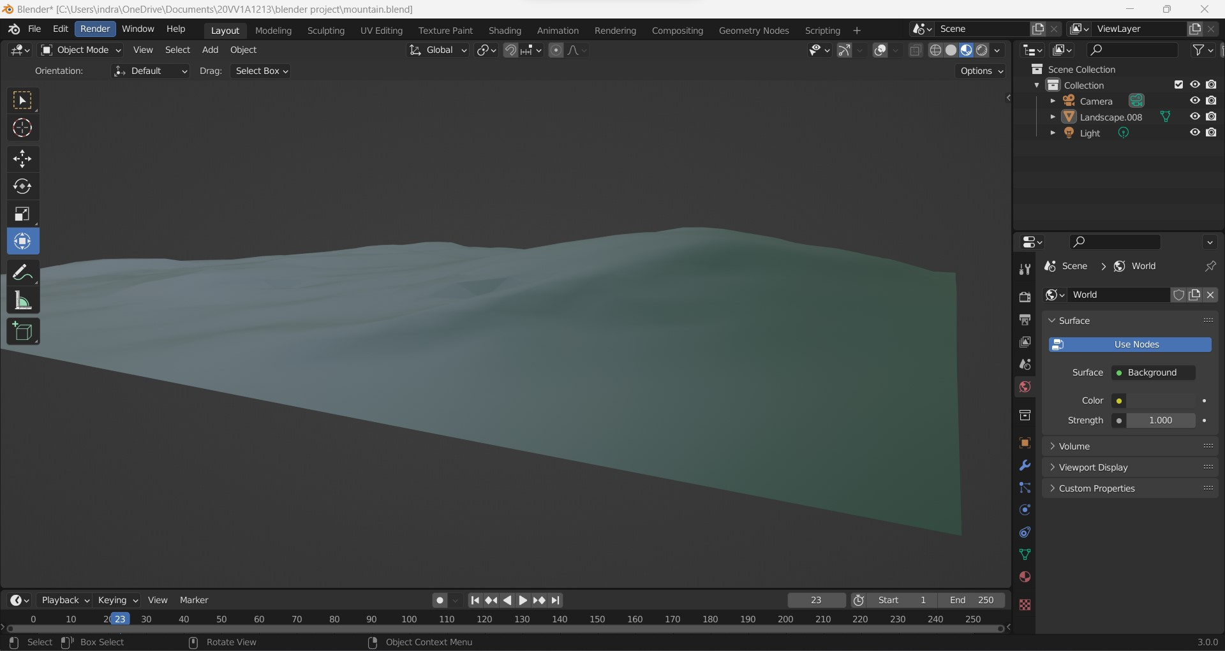
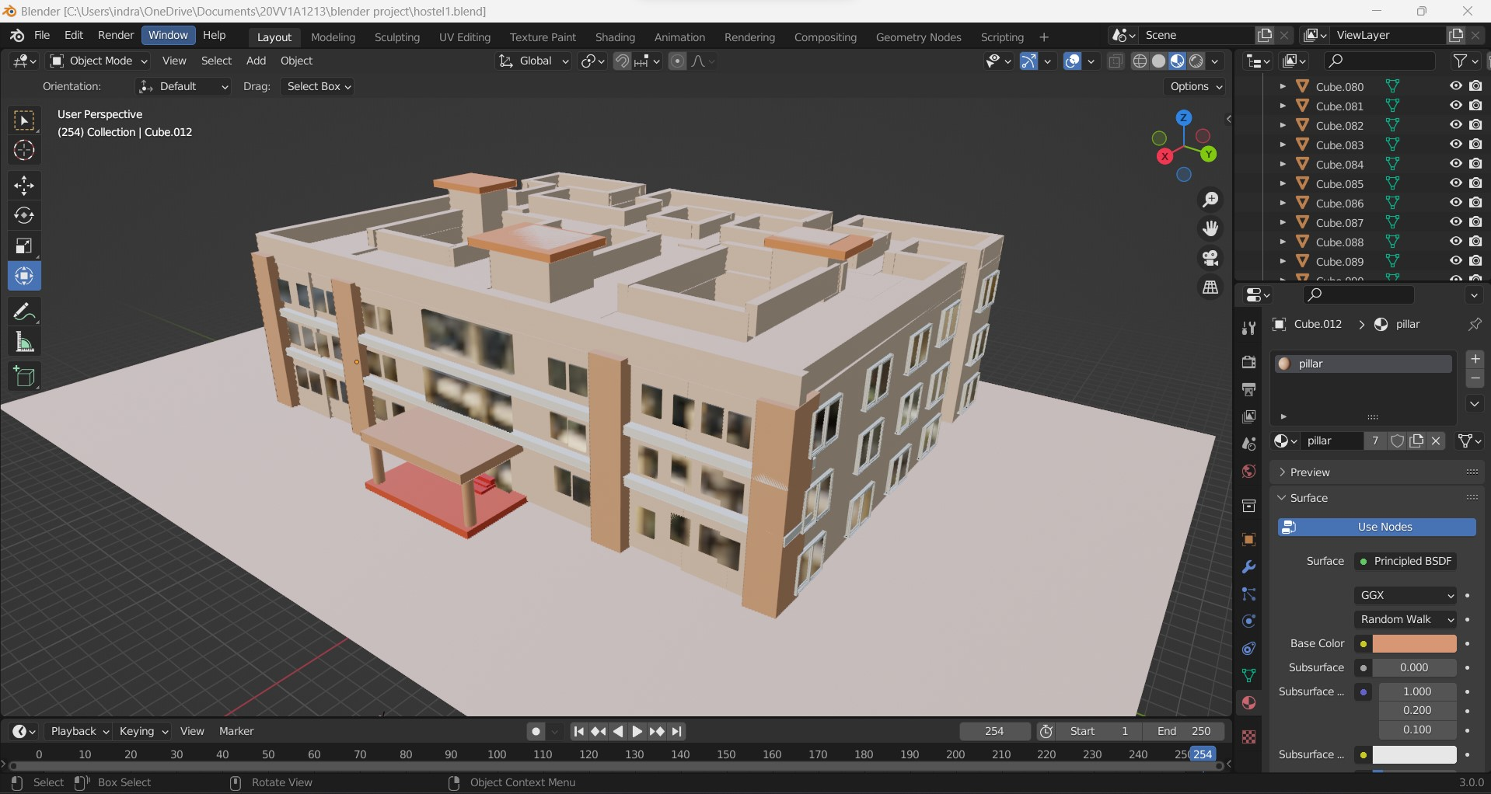
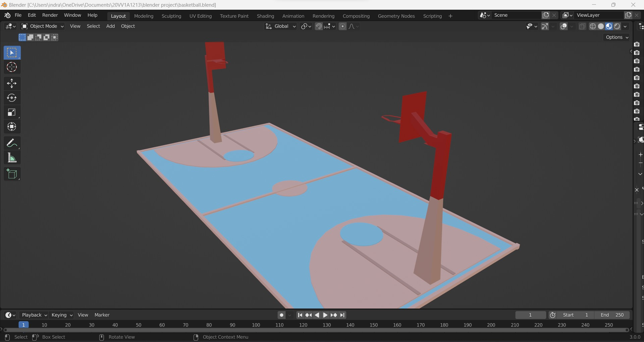
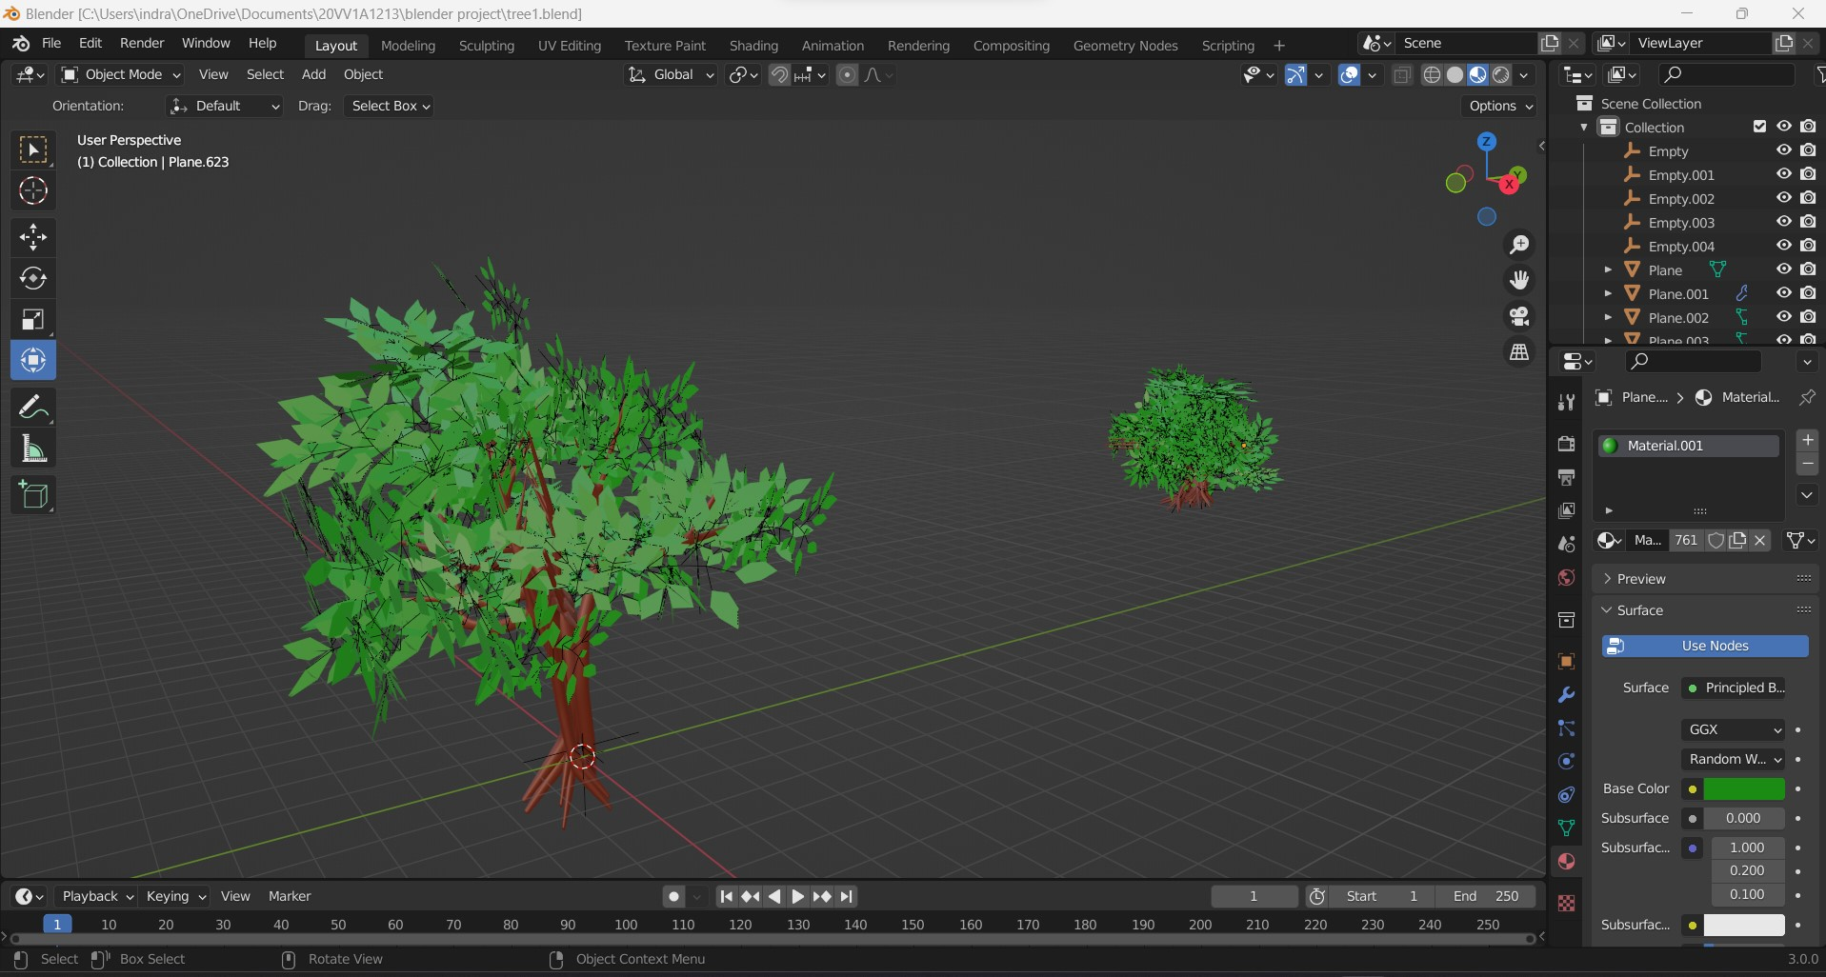
DESIGNING THE PROPERTIES contd..
LANDSCAPE
AB-II
BASKET BALL
TREES

Slide 8
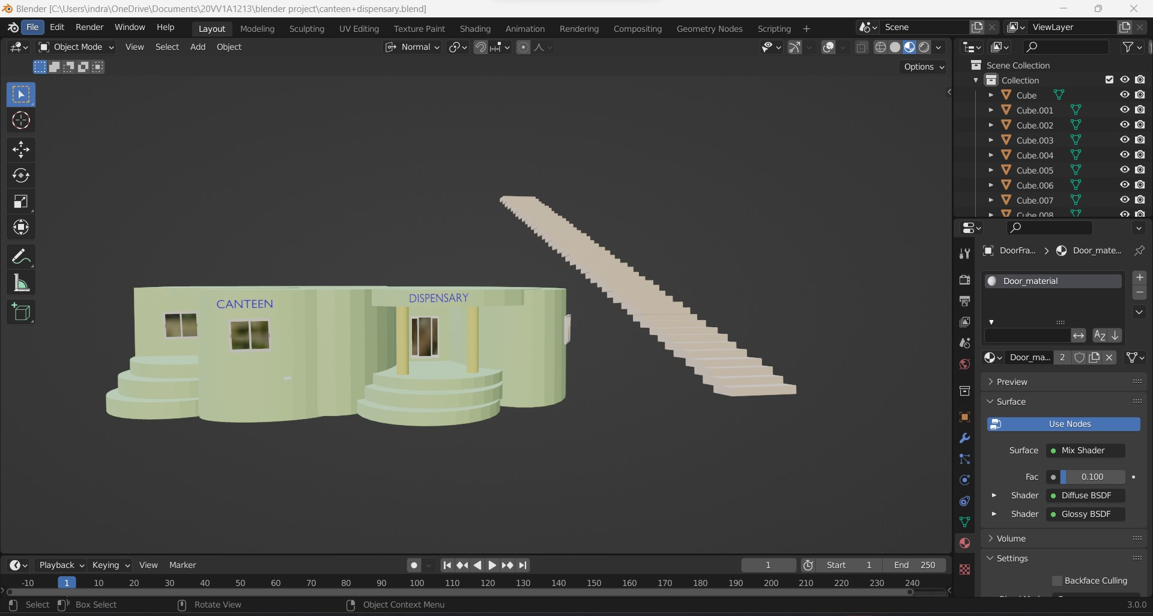
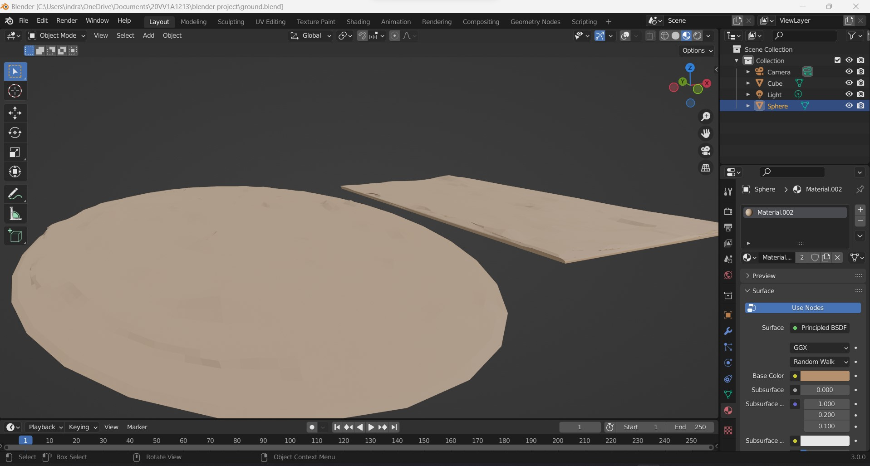
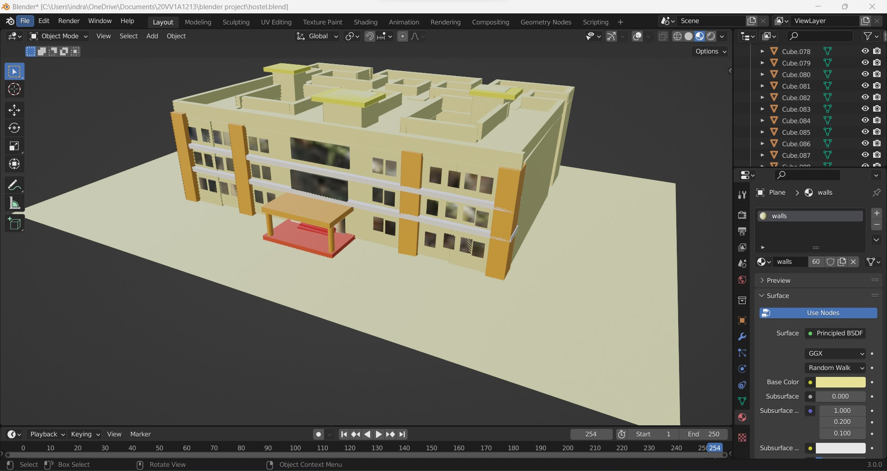
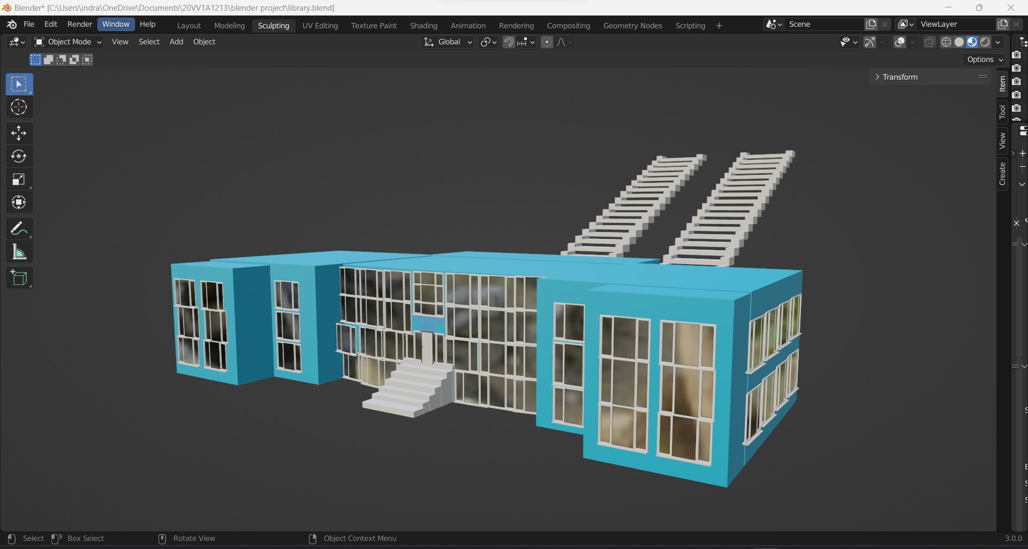
DESIGNING THE PROPERTIES contd..
CANTEEN & DISPENSARY
GROUNDS
GIRLS HOSTEL
LIBRARY

Slide 9
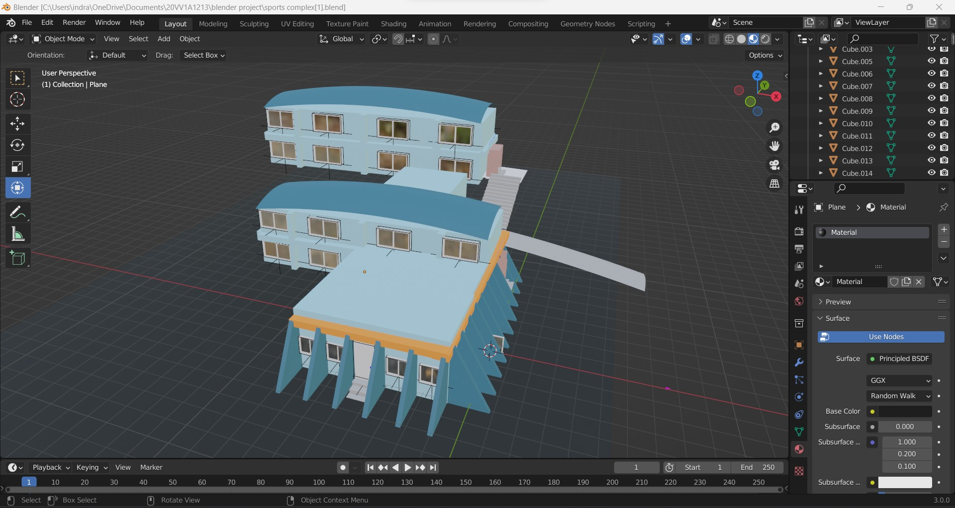
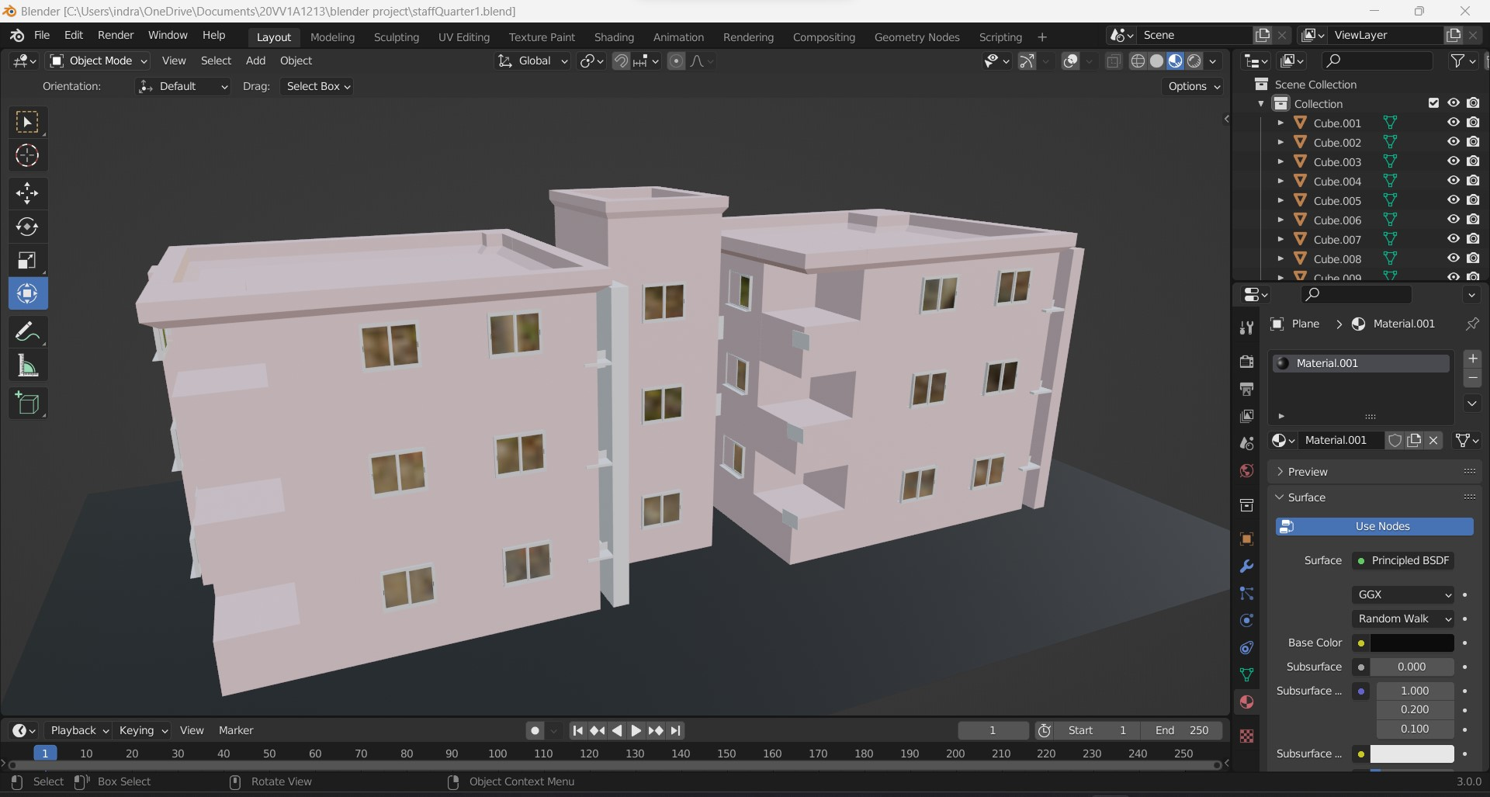
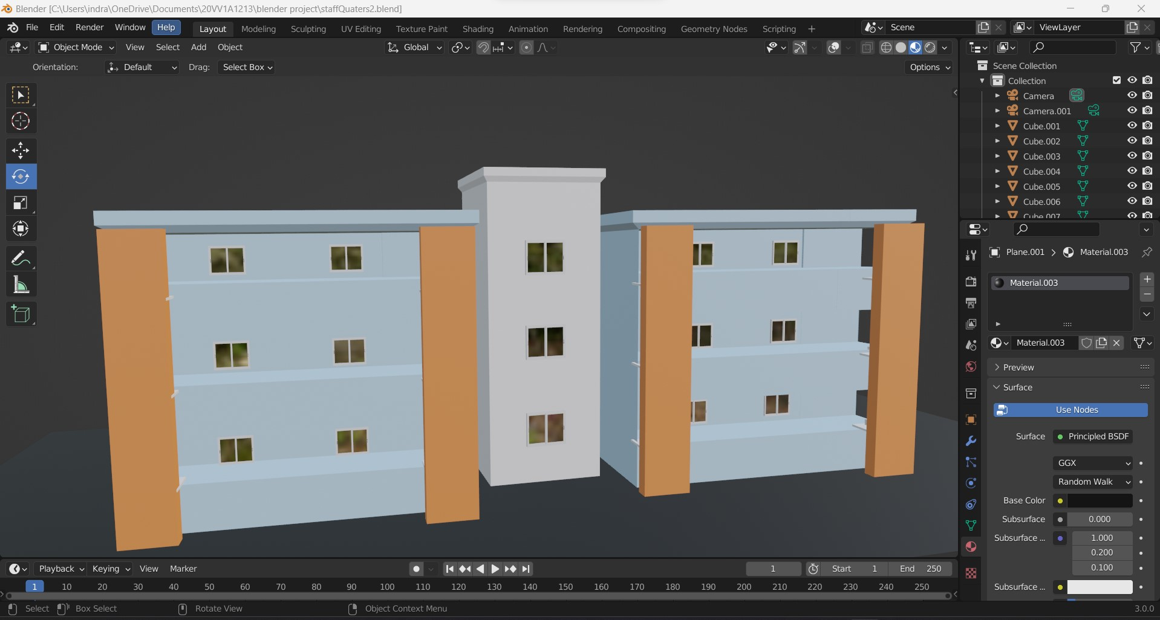
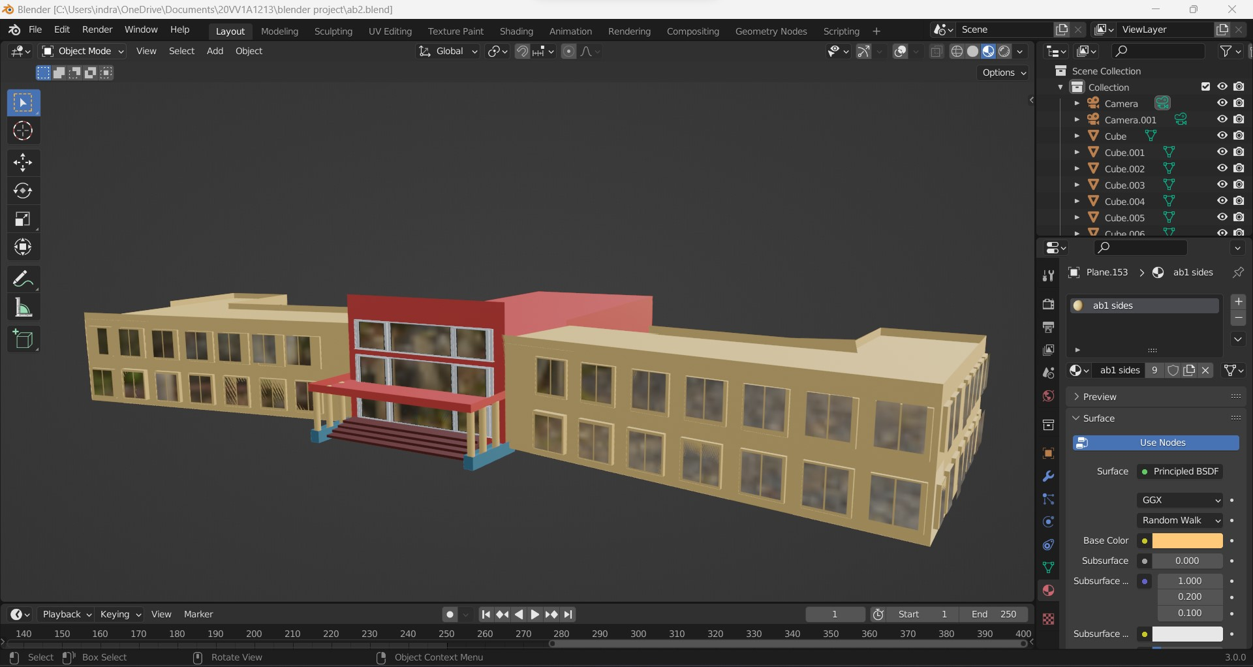
DESIGNING THE PROPERTIES contd..
SPORTS COMPLEX
STAFF QUARTERS -I
STAFF QUARTERS-II
AB-I

Slide 10
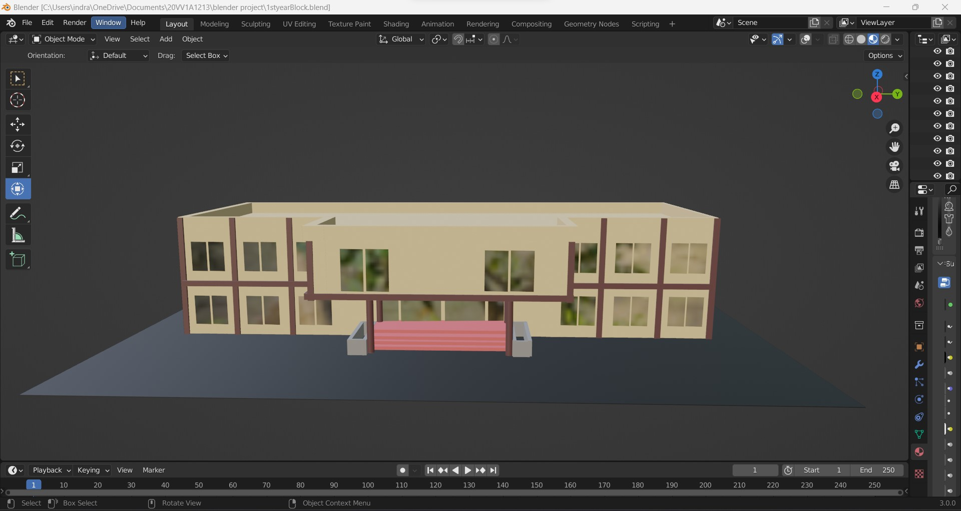
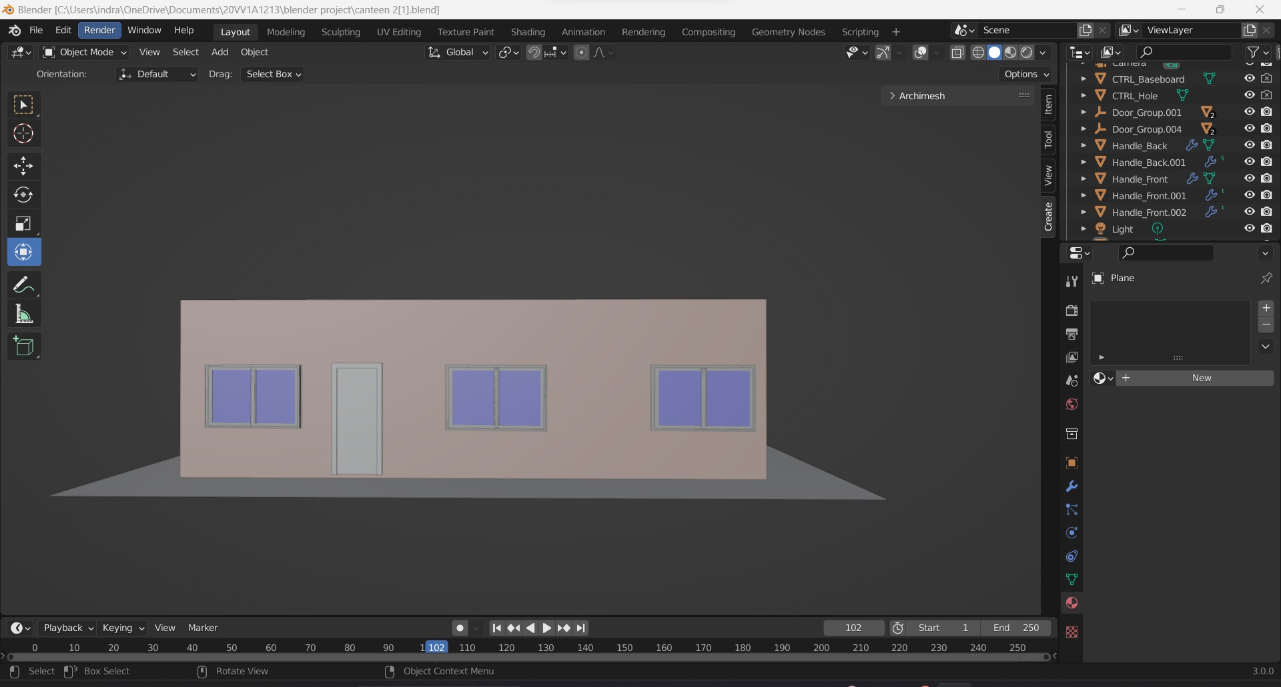
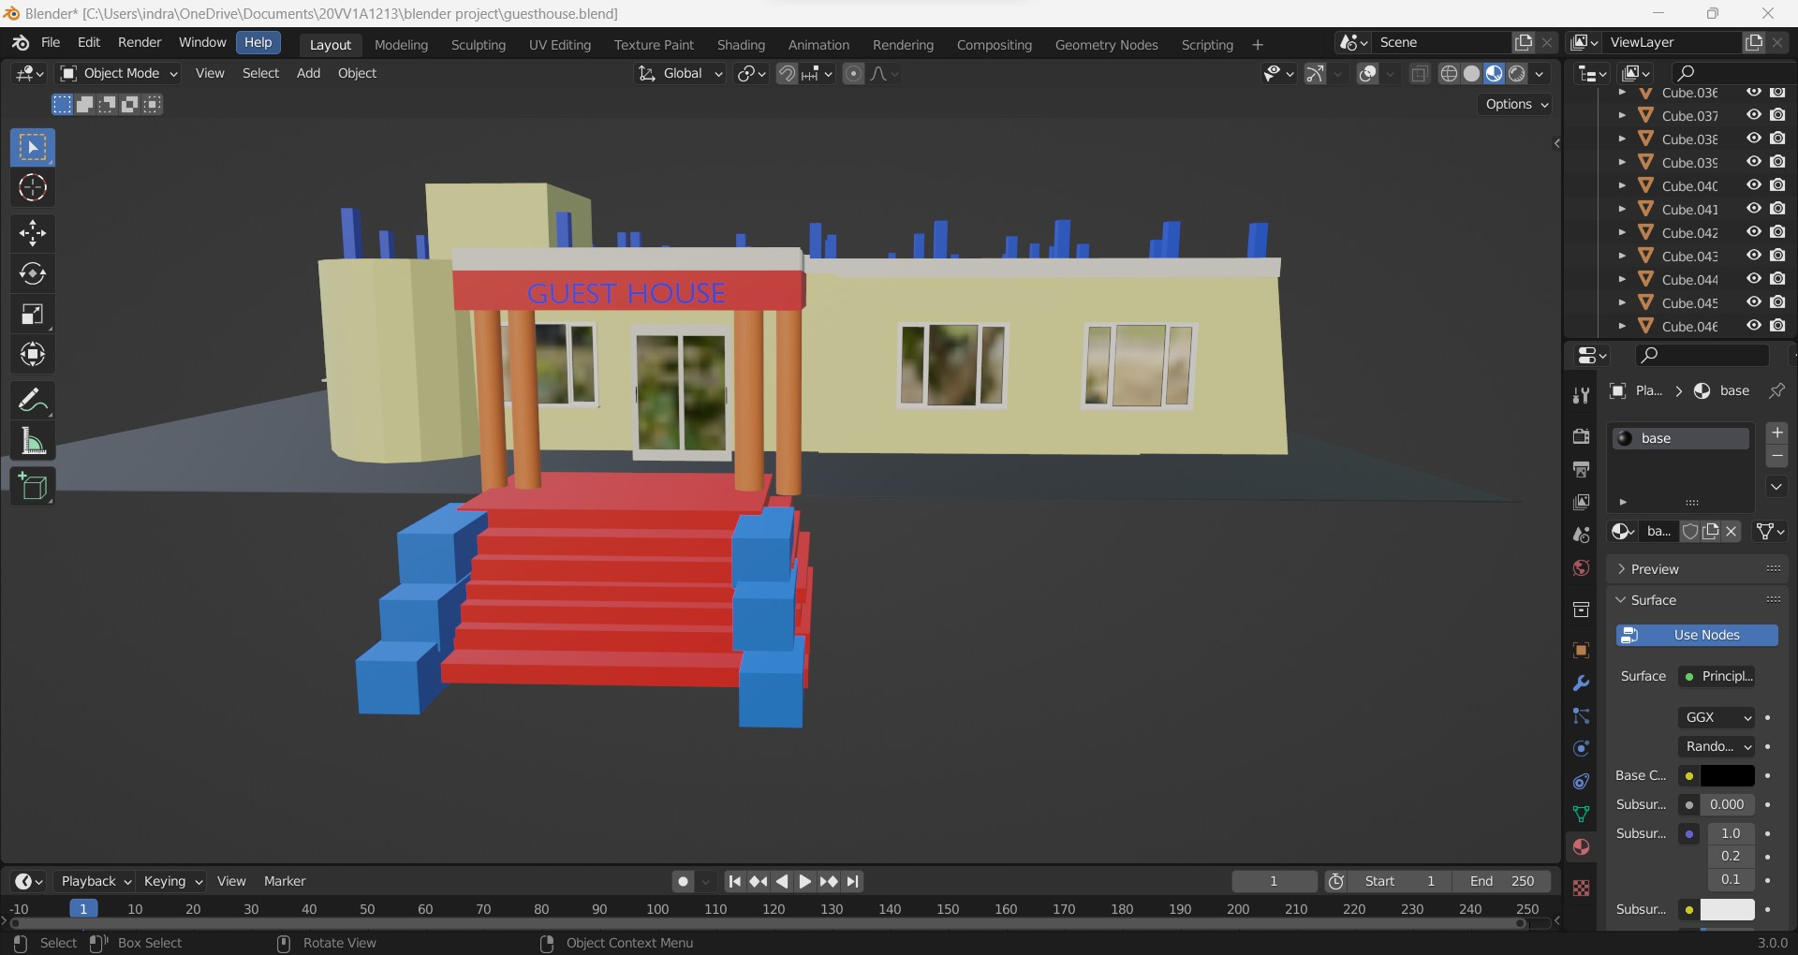
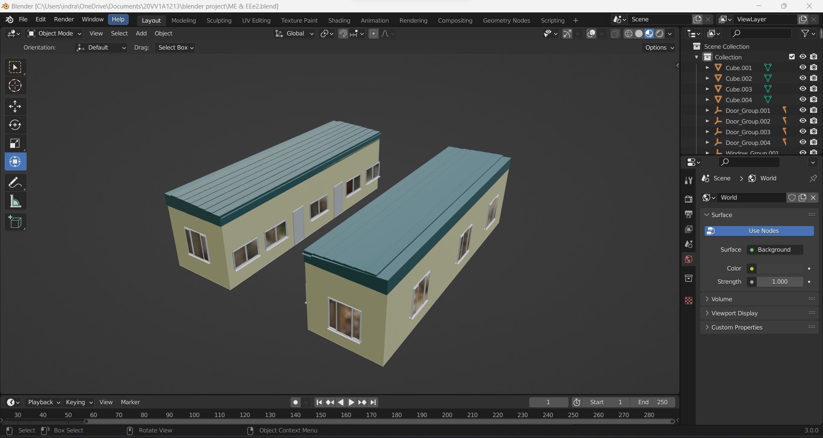
DESIGNING THE PROPERTIES contd..
1st YEAR BLOCK
CANTEEN
GUEST HOUSE
MECHANICAL LABS

Slide 11
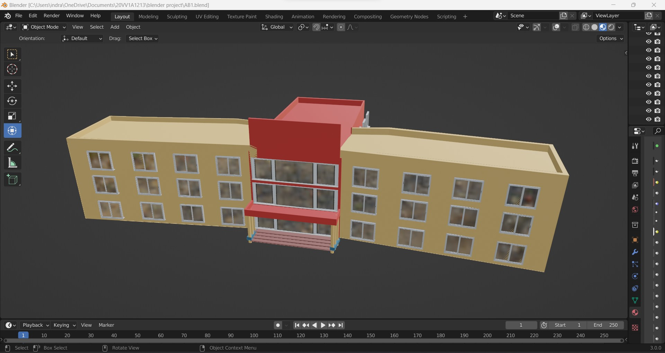
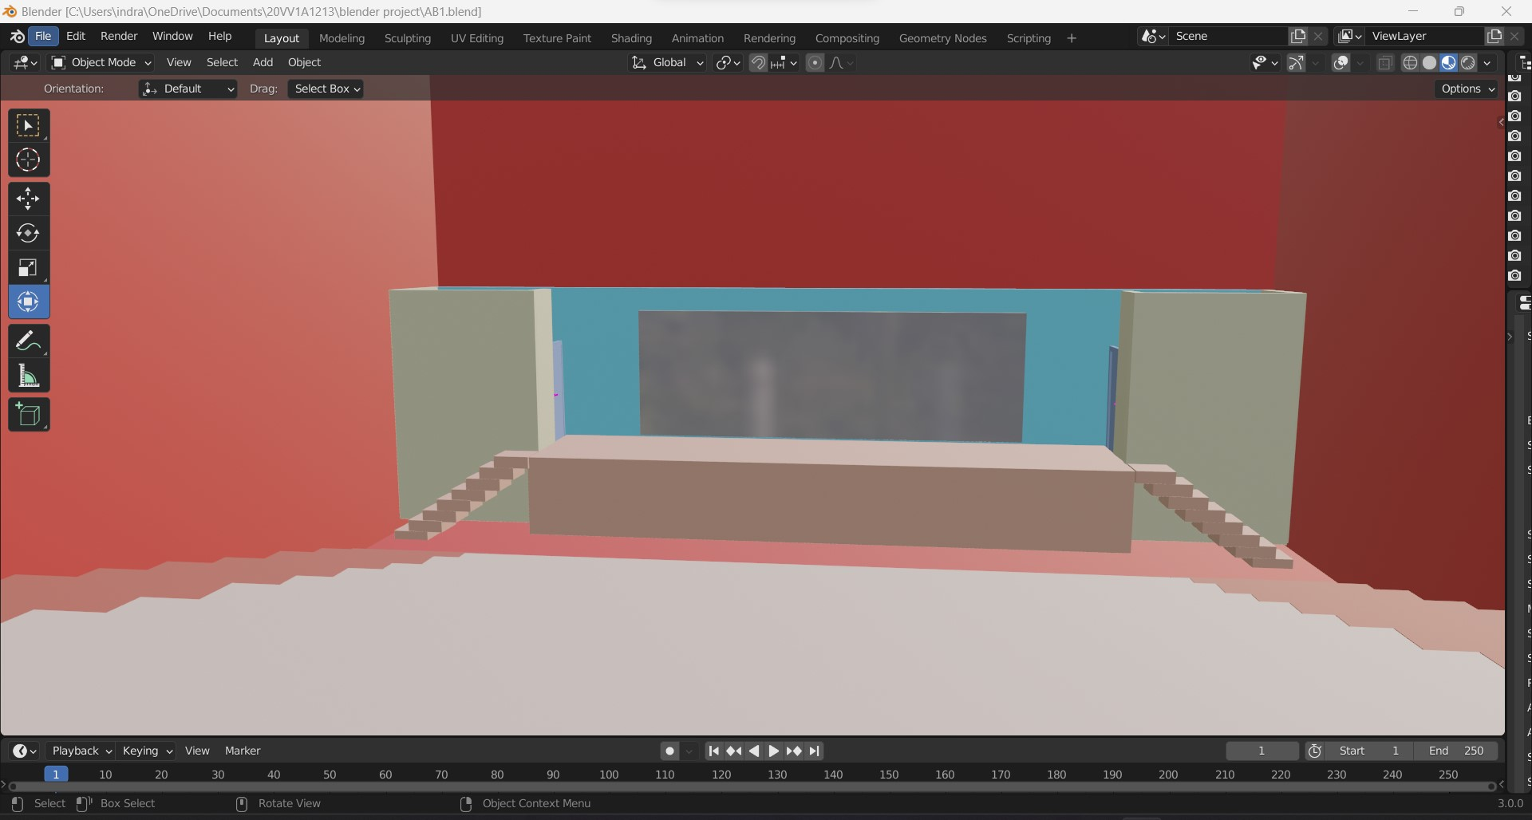
DESIGNING THE PROPERTIES contd..
AB-II
AUDITORIUM

Slide 12
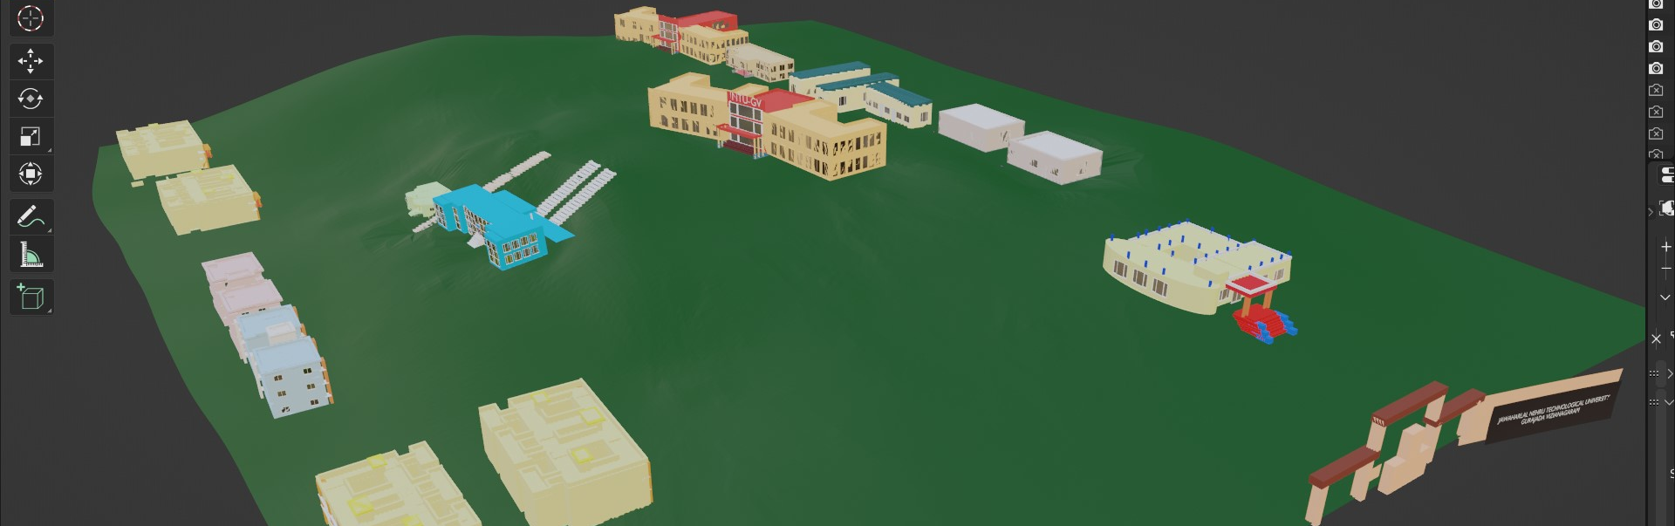
ARRANGING THE
PROPERTIES
Arranging the properties according to the layout is important
After creating all the properties of the college we started arranging them according to the layout
Added all the individual elements like trees ,roads, play grounds, details

Slide 13
ARRANGING THE RPOPERTIES contd..
THE JNTU-GV

Slide 14
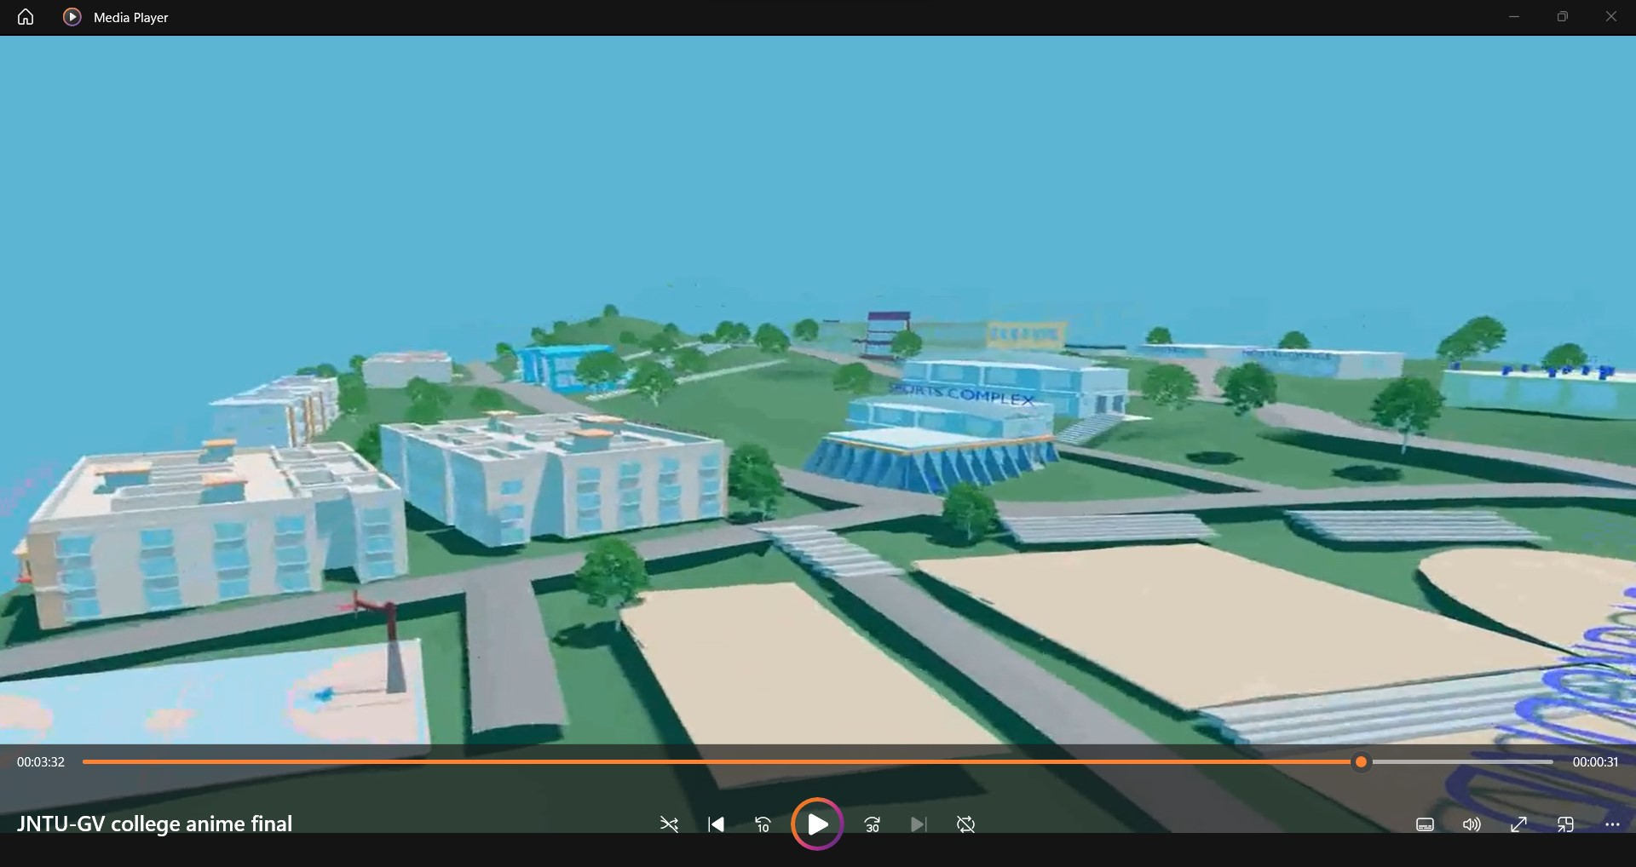
RENDERING PROCESS
Rendering is used in both 2D and 3D computer animation. It is the process of getting the final assembled animation scenes or pieces out of the computer in the format of a sequence of individual frames. The aim of rendering is to generate a series of individual pixel based frames or a video clip.
Press SHIFT A, it displays a dropdown menu in that select the camera option.
After selecting the camera, adjust the camera settings by clicking ‘G’ and adjust the x and y axis and set ‘0’ for camera view.
Go to the right of the blender and find out Render properties option.
In Render properties,
Select render engines and set as ‘cycles’.
Select Denoise and keep a tick.
Range of the max sample should be 100.
Remove the tick from the Noise Threshold.
Set the output properties and encoding properties.
Press ctrl+F12 for automatic rendering process.
After rendering process a video will be saved.

Slide 15
The way to get started is to quit talking and begin doing.

Slide 16
Thank you
B. KAVYA SRI
B. SAI KIRAN
D. M. VISHNU PRIYA
G. SIVA RAMA KRISHNA
M.S.S.P. ANURAAG
P. DILEEP KUMAR
R. SANGEETHA

